Slide 1
ModelSim Installation and Licensing Guide

Slide 2
Go to modelsim
http://www.mentor.com/products/fpga/model
Click ModelSim Student edition
click

Slide 3
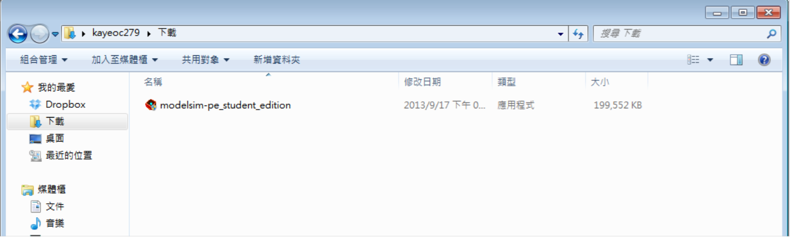
Download & Setup
Click here
Use this to install

Slide 4
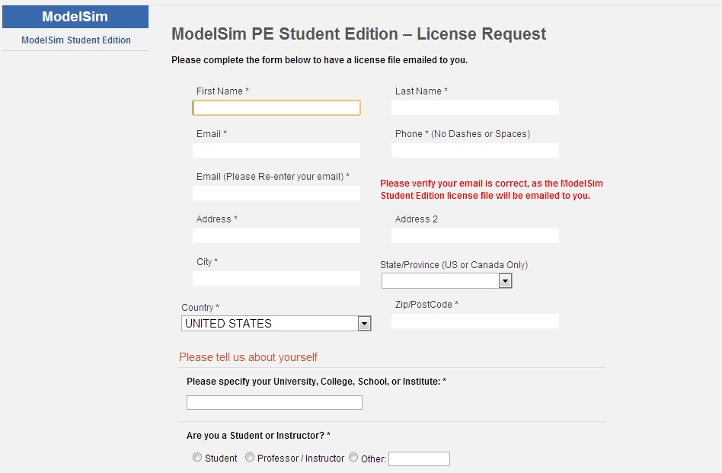
Registration
At the end of the installation process, select Finish and a browser window will open with the License Request form. Once your request has been received the ModelSim PE Student Edition license file will be generated, matched to your host computer and will be emailed to you along with license installation instructions.

Slide 5
Final installation instruction
1) Save the attached file with the name 'student_license.dat' to the top level
installation directory for ModelSim PE Student Edition (e.g., c:/modeltech_pe_edu).
This is the directory that contains that sub-directory 'win32pe_edu.'
2) Do not edit the file 'student_license.dat' in any way, or the license will not work.
3) You should now be able to run ModelSim PE Student Edition.

Slide 6
How to use ModelSim

Slide 7
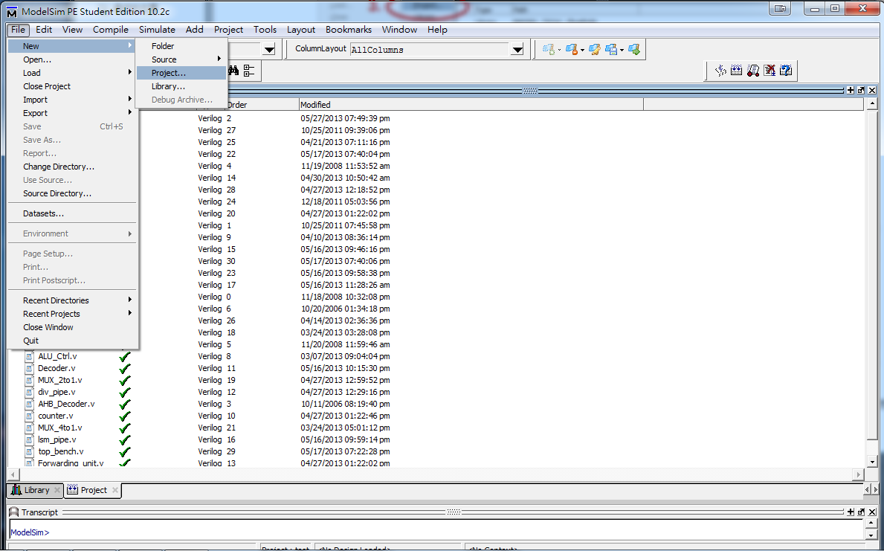
New a project

Slide 8
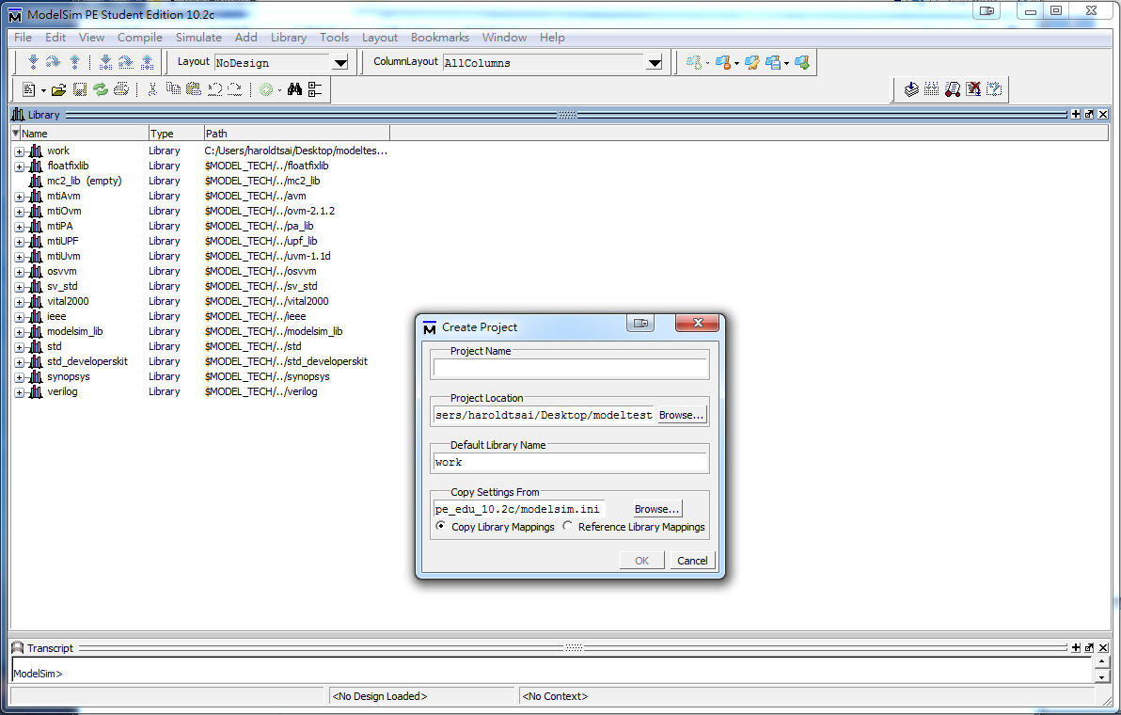
New a project
Project name
path

Slide 9
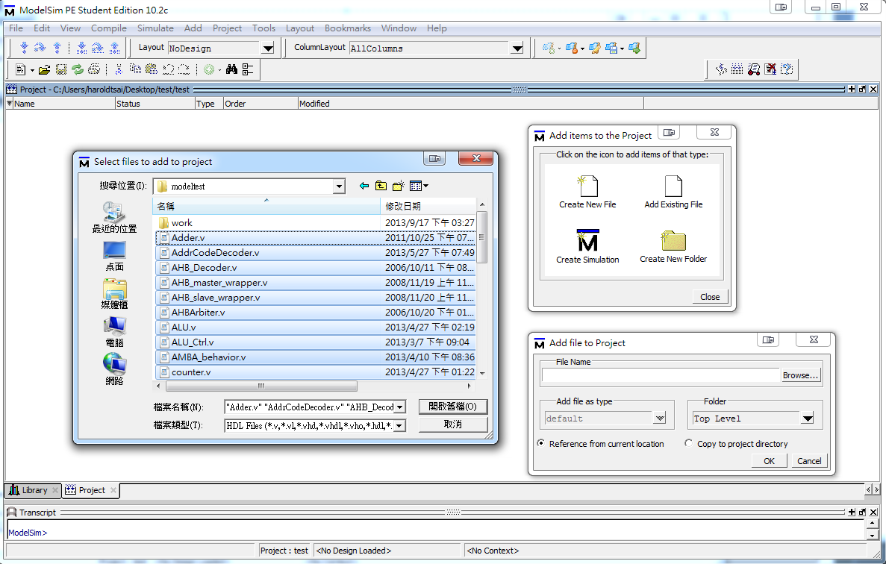
Add Files
2.
1.Add .v files you write
3.

Slide 10
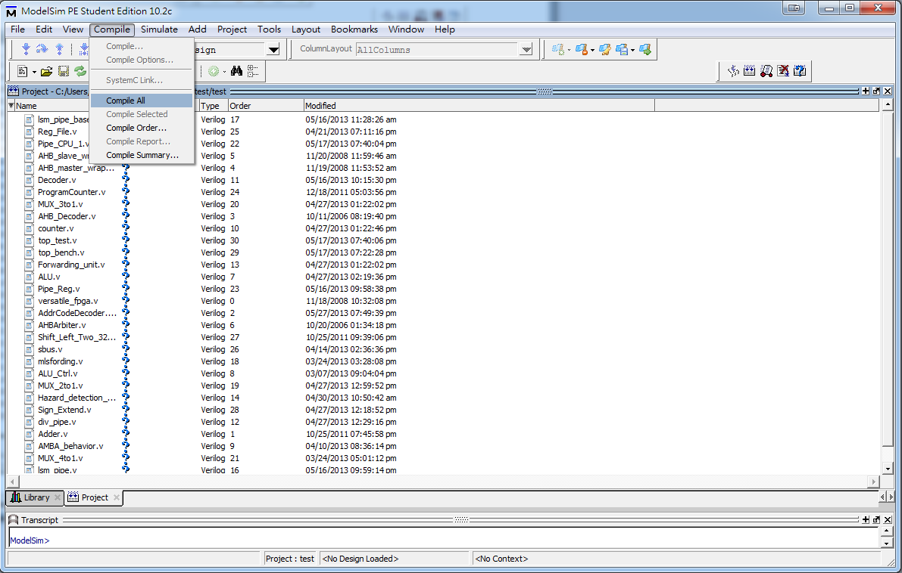
Compile
2.
3.
1.
Notes:
4.未編譯過的檔案會呈現?
若有語法錯誤會顯示X

Slide 11
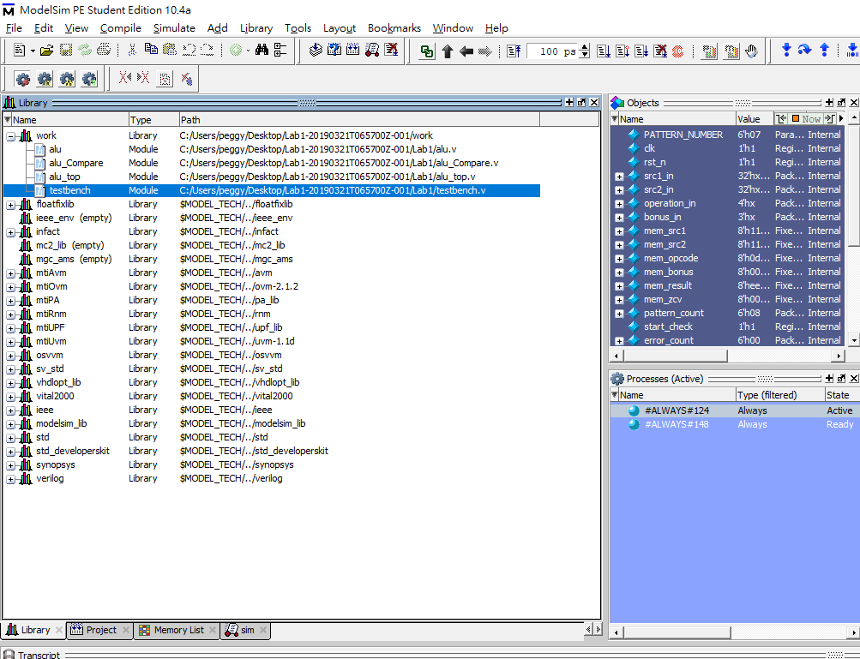
Simulate
2.Right click on testbench
and click “simulate”
1.

Slide 12
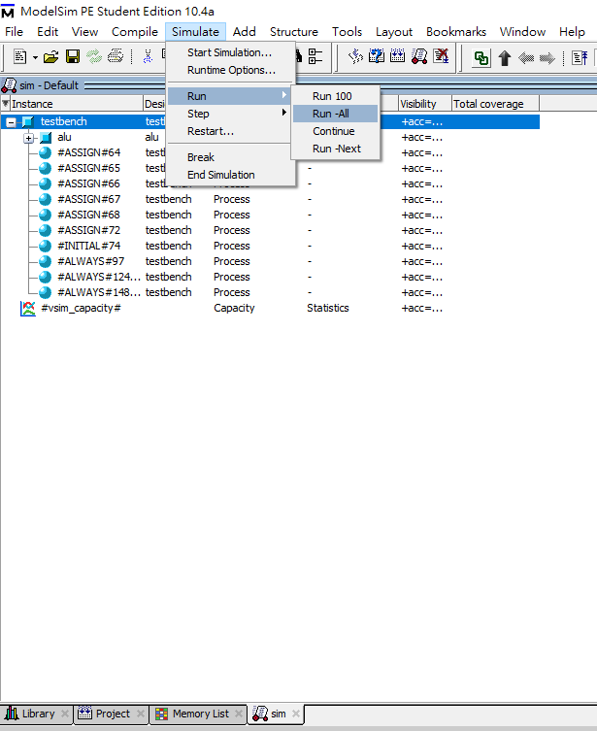
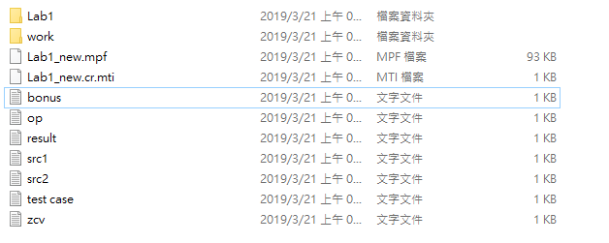
Simulate – Run all
1. Please put all the .txt files and project(.mpf) in the same folder
2.

Slide 13
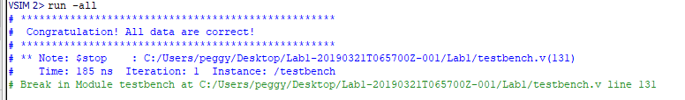
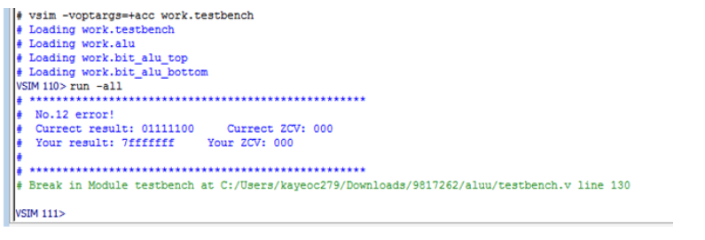
Result
All case pass
Partial error

